Slide 1
OPA on AWS
FSI PACE Platform engineering team
fsi-pace-pe@amazon.com

Slide 2
Agenda
Why is developer experience important?
Introduction to developer platforms
Common enterprise patterns
OPA on AWS

Slide 3
Why is developer experience important?

Slide 4
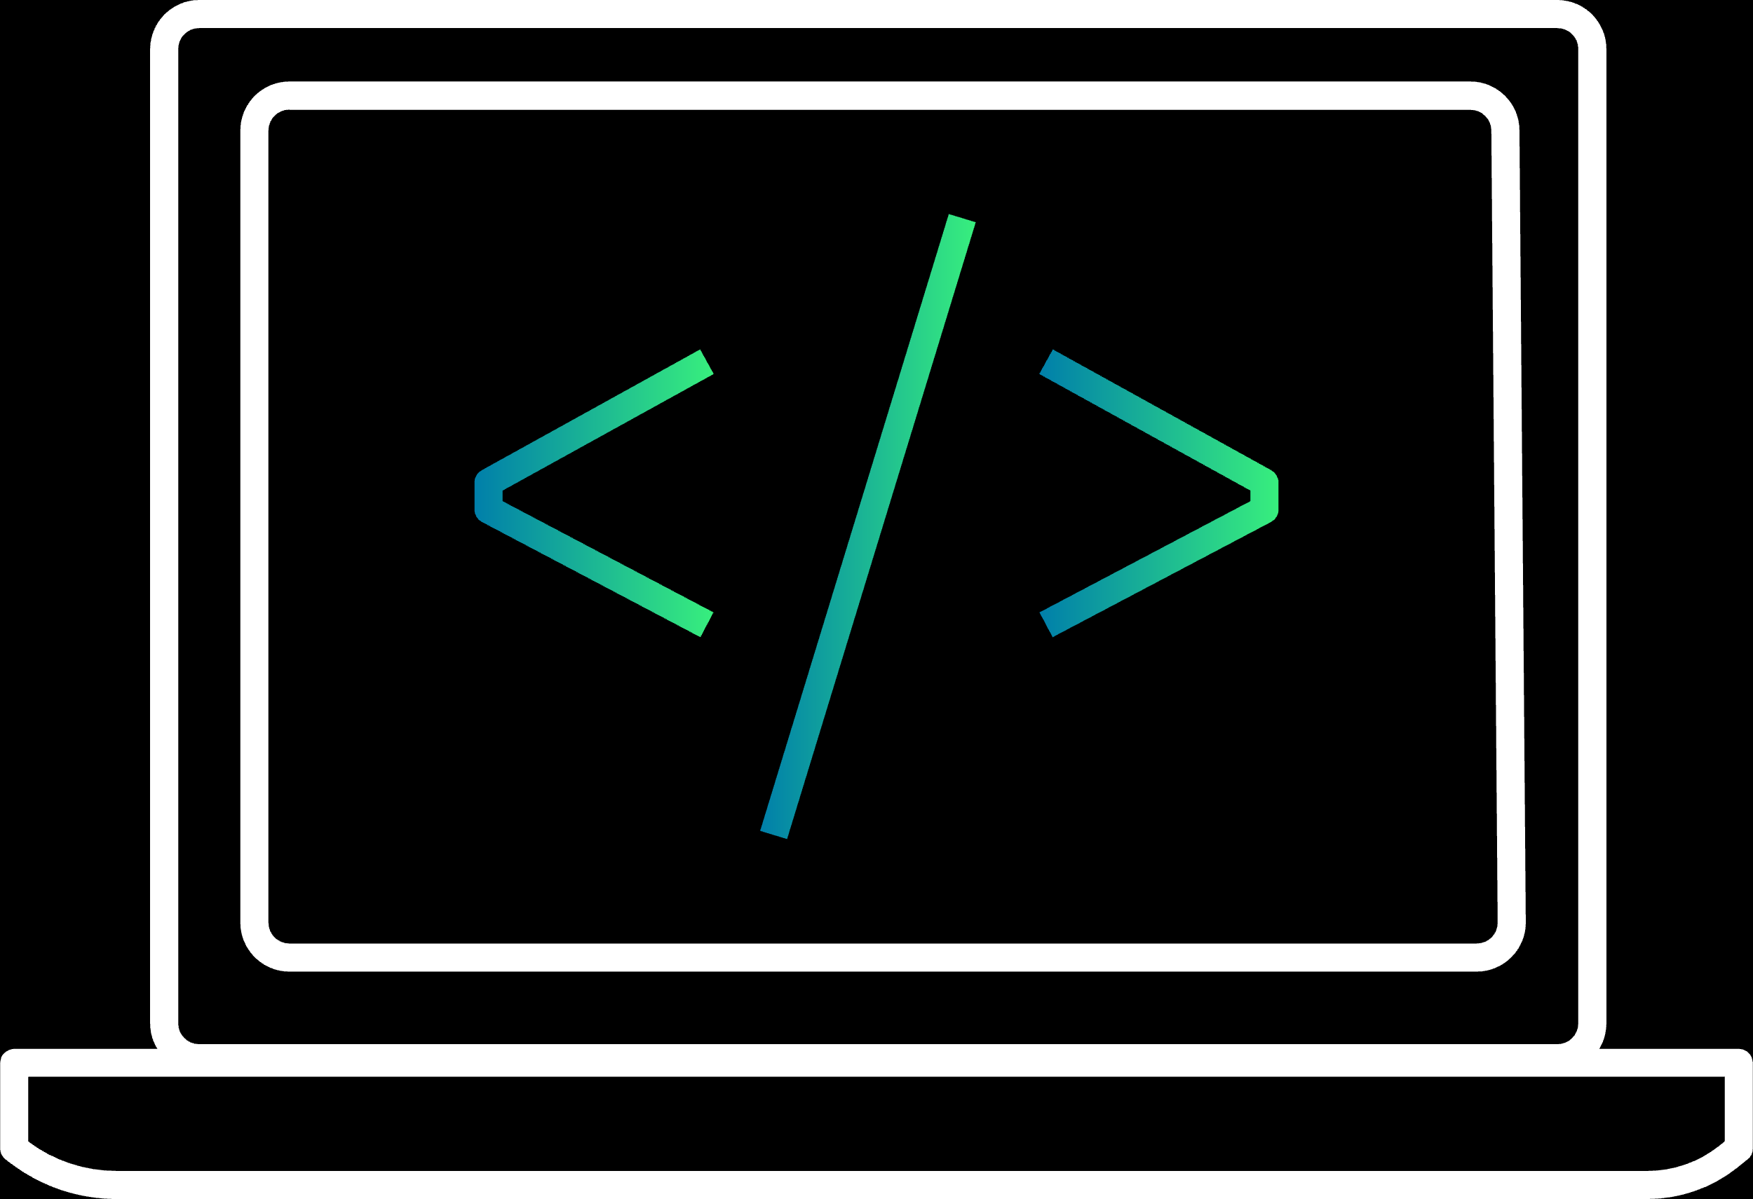
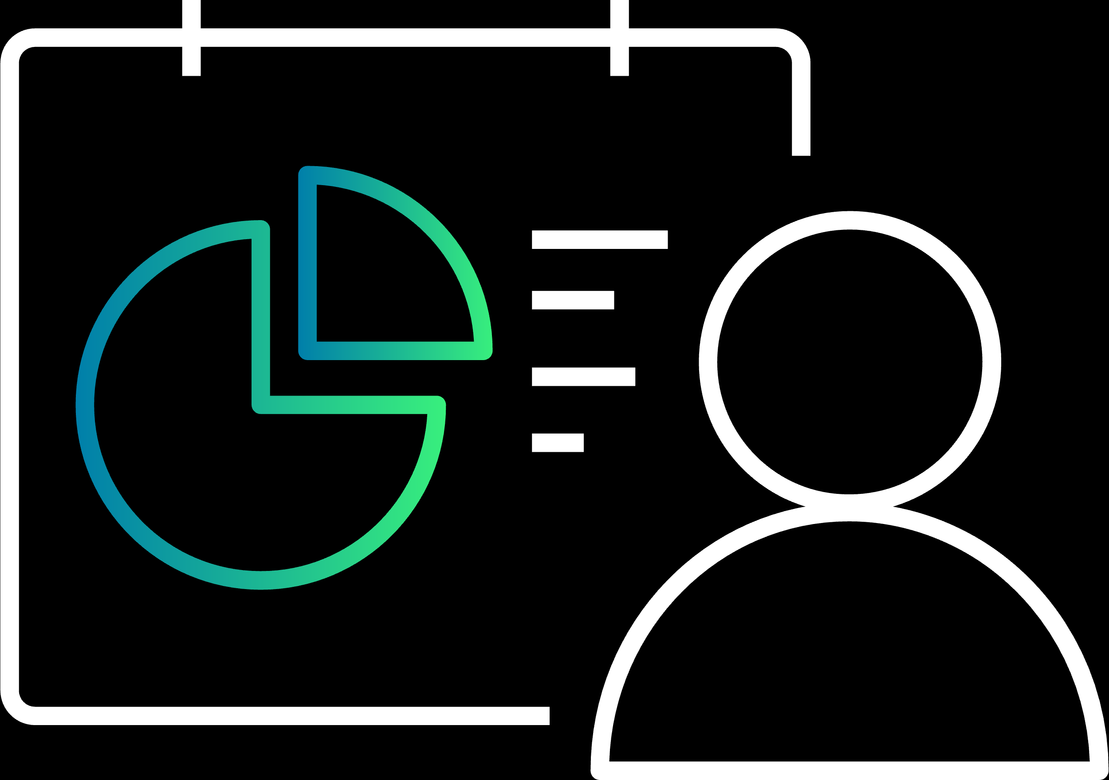
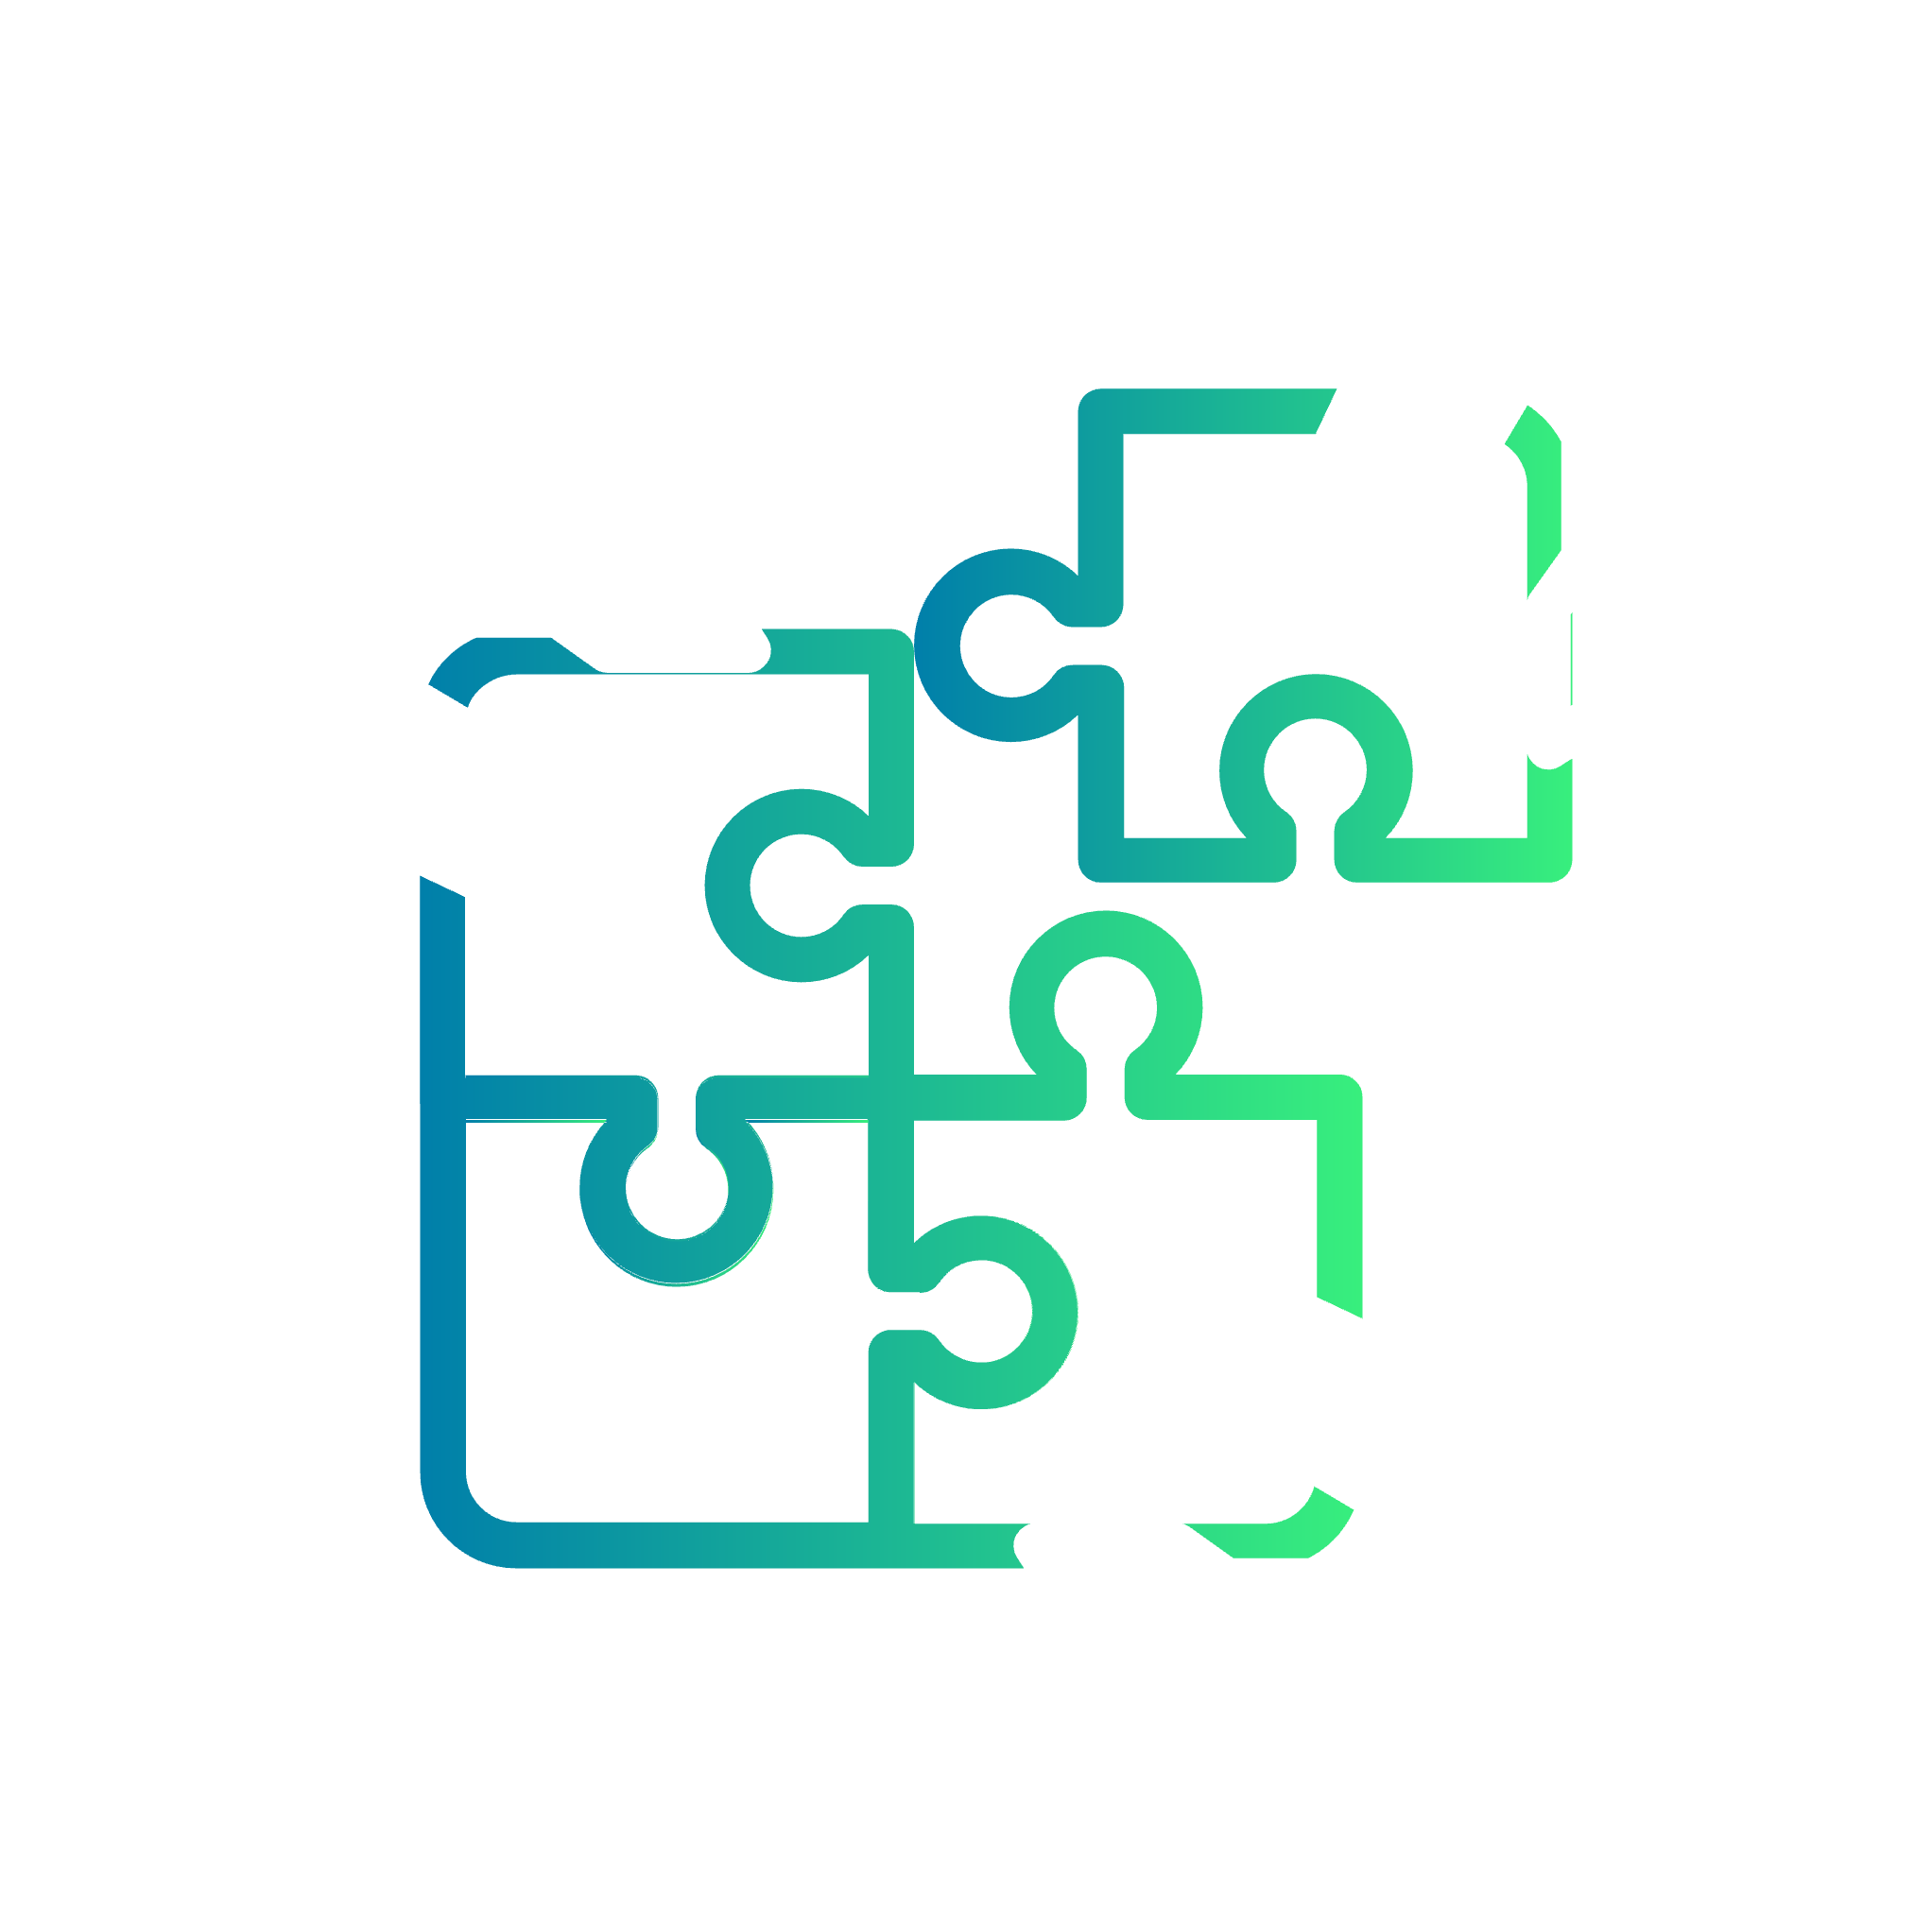
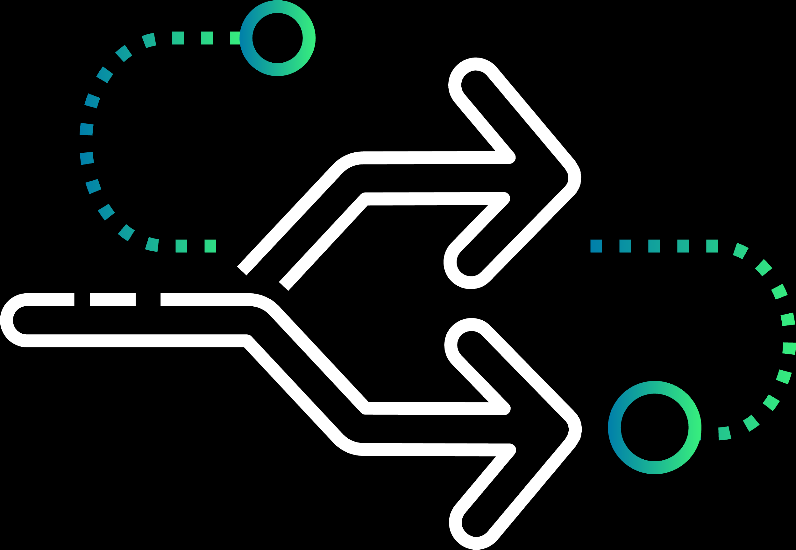
Developer satisfaction impact
Productivity
Efficiency
Innovation
Collaboration
Reduce Friction
Adoption
Retention
Happiness

Slide 5
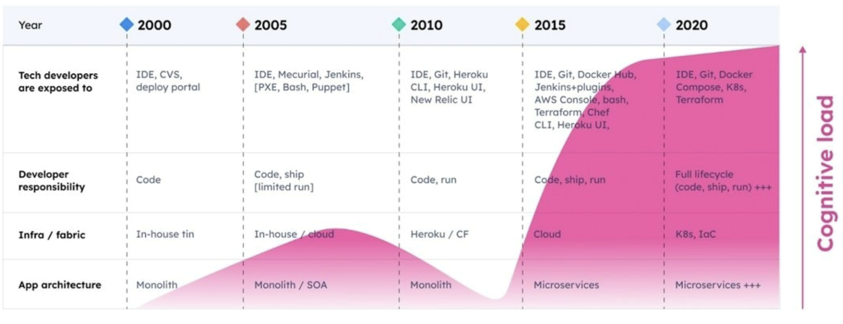
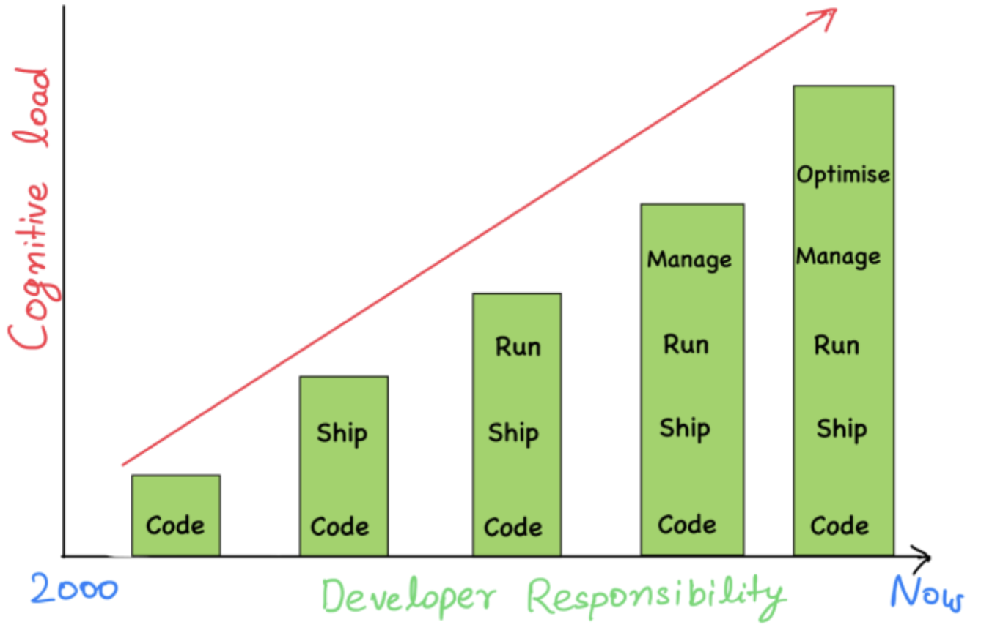
Technology vs. developers

Slide 6
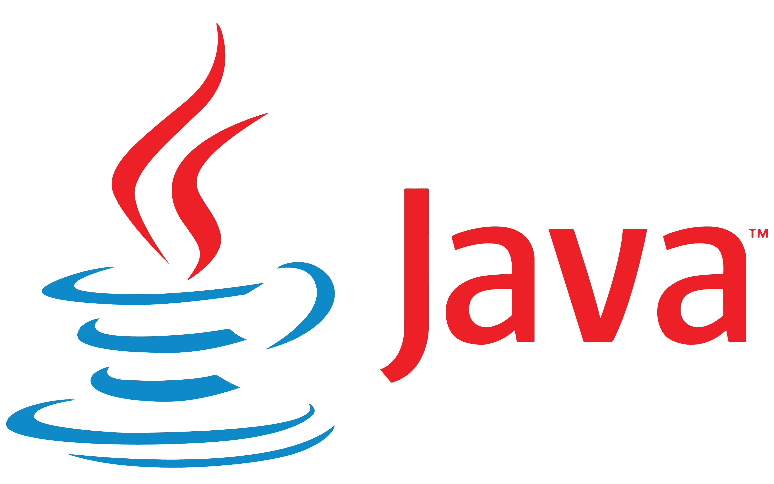
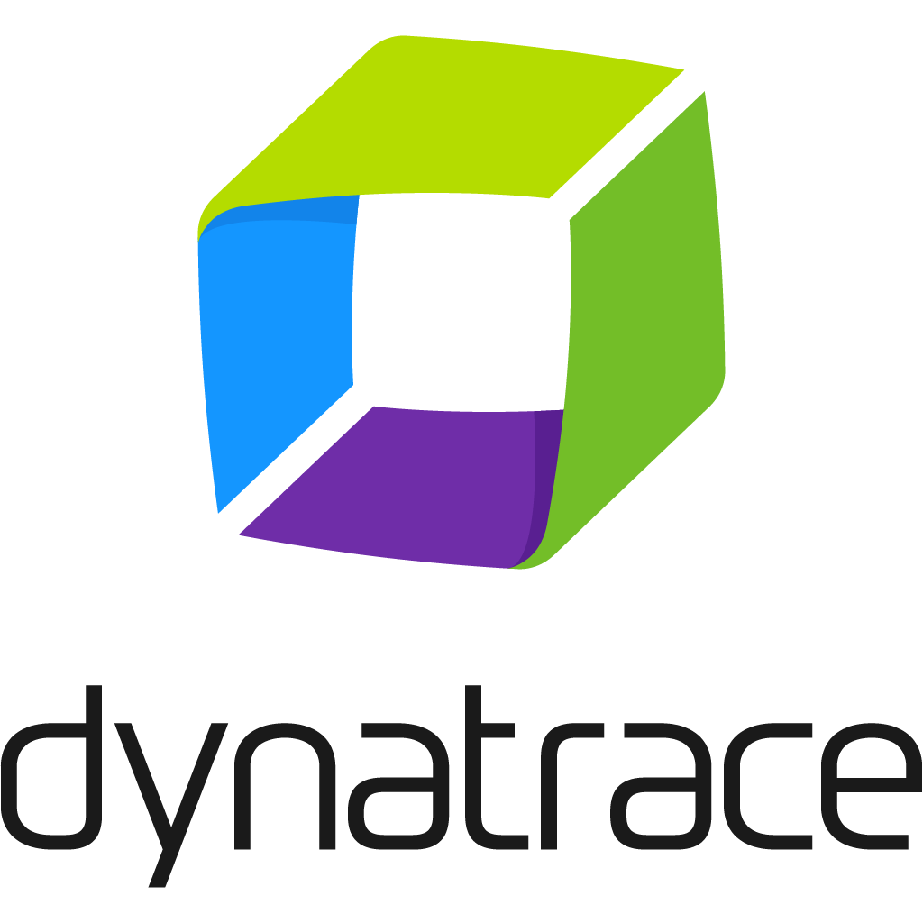
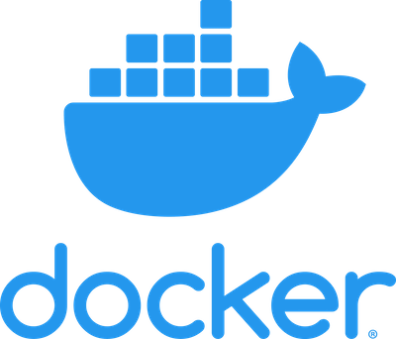
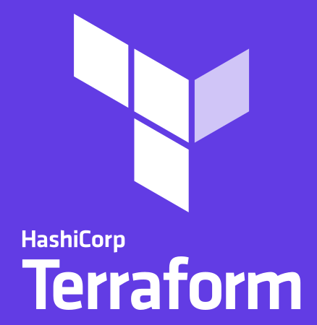
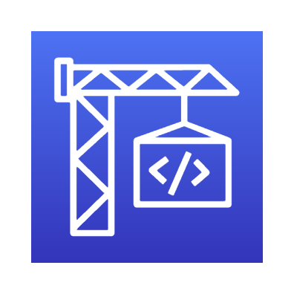
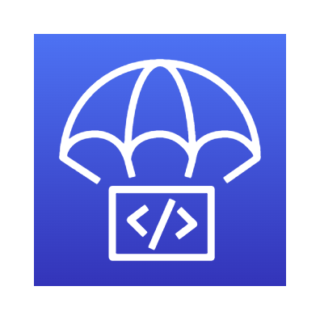
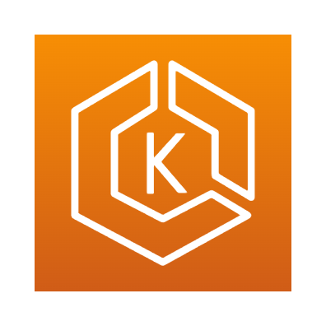
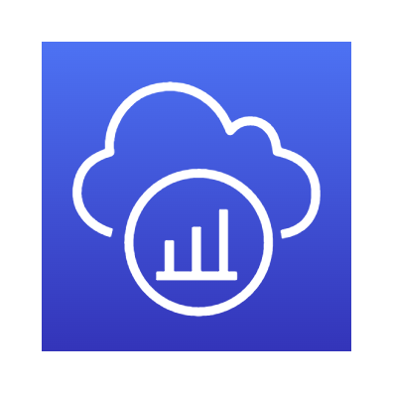
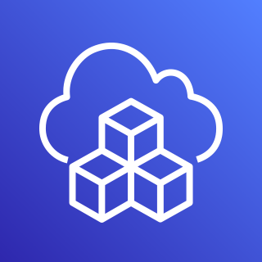
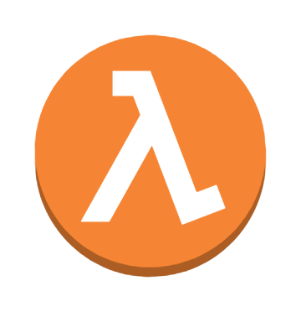
Developer Tools
Develop
Build
Ship
Run
Manage
Optimize
AWS EKS
AWS CloudWatch
AWS XRay
AWS CodeBuild
AWS CodeDeploy
AWS ECS
AWS MSP
AWS AutoScale
CDK
AWS Lambda

Slide 7
Introduction to developer platforms

Slide 8
Closing the gap for varied cloud skills
Log Archive Account
Audit Account
Security Account
Landing Zone Core
Networking Account
Account Factory
Now what?
Dev Account A
UAT Account A
Workloads
Development Team
Prod Account A

Slide 9
Scaling platform engineers
9

Slide 10
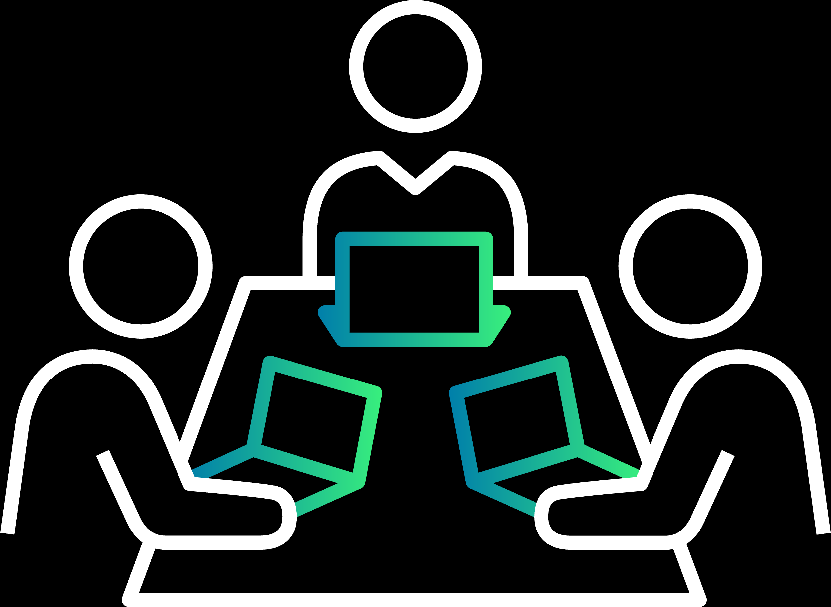
Better communication for enterprise personas
Business owners
Customer requirements
Non-functional requirements
Application Developers
Platform Engineering Team
Help & support
Guidance
blueprints
Sample code
automation

Slide 11
Common enterprise Patterns

Slide 12
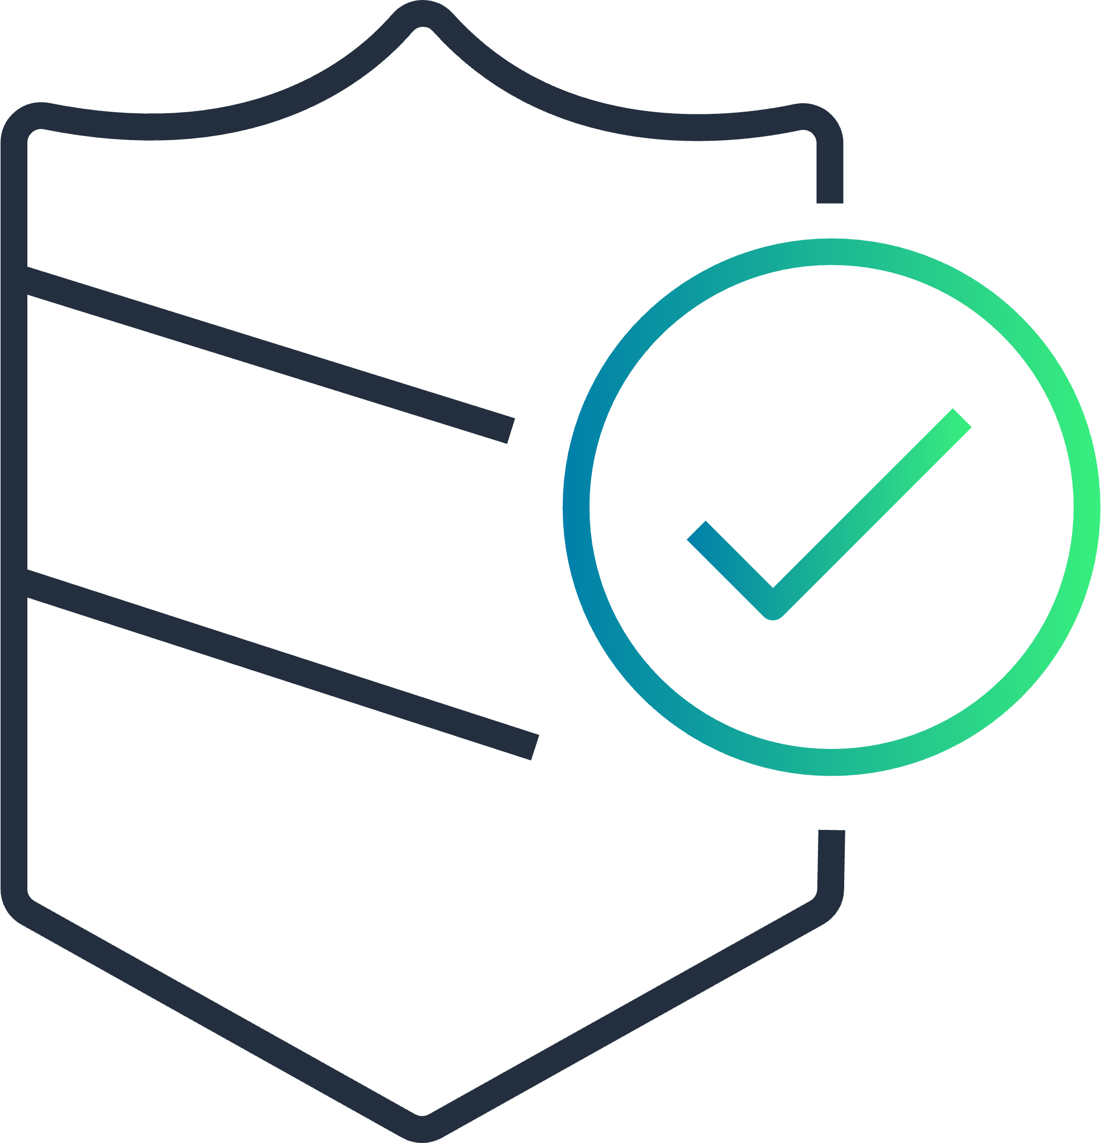
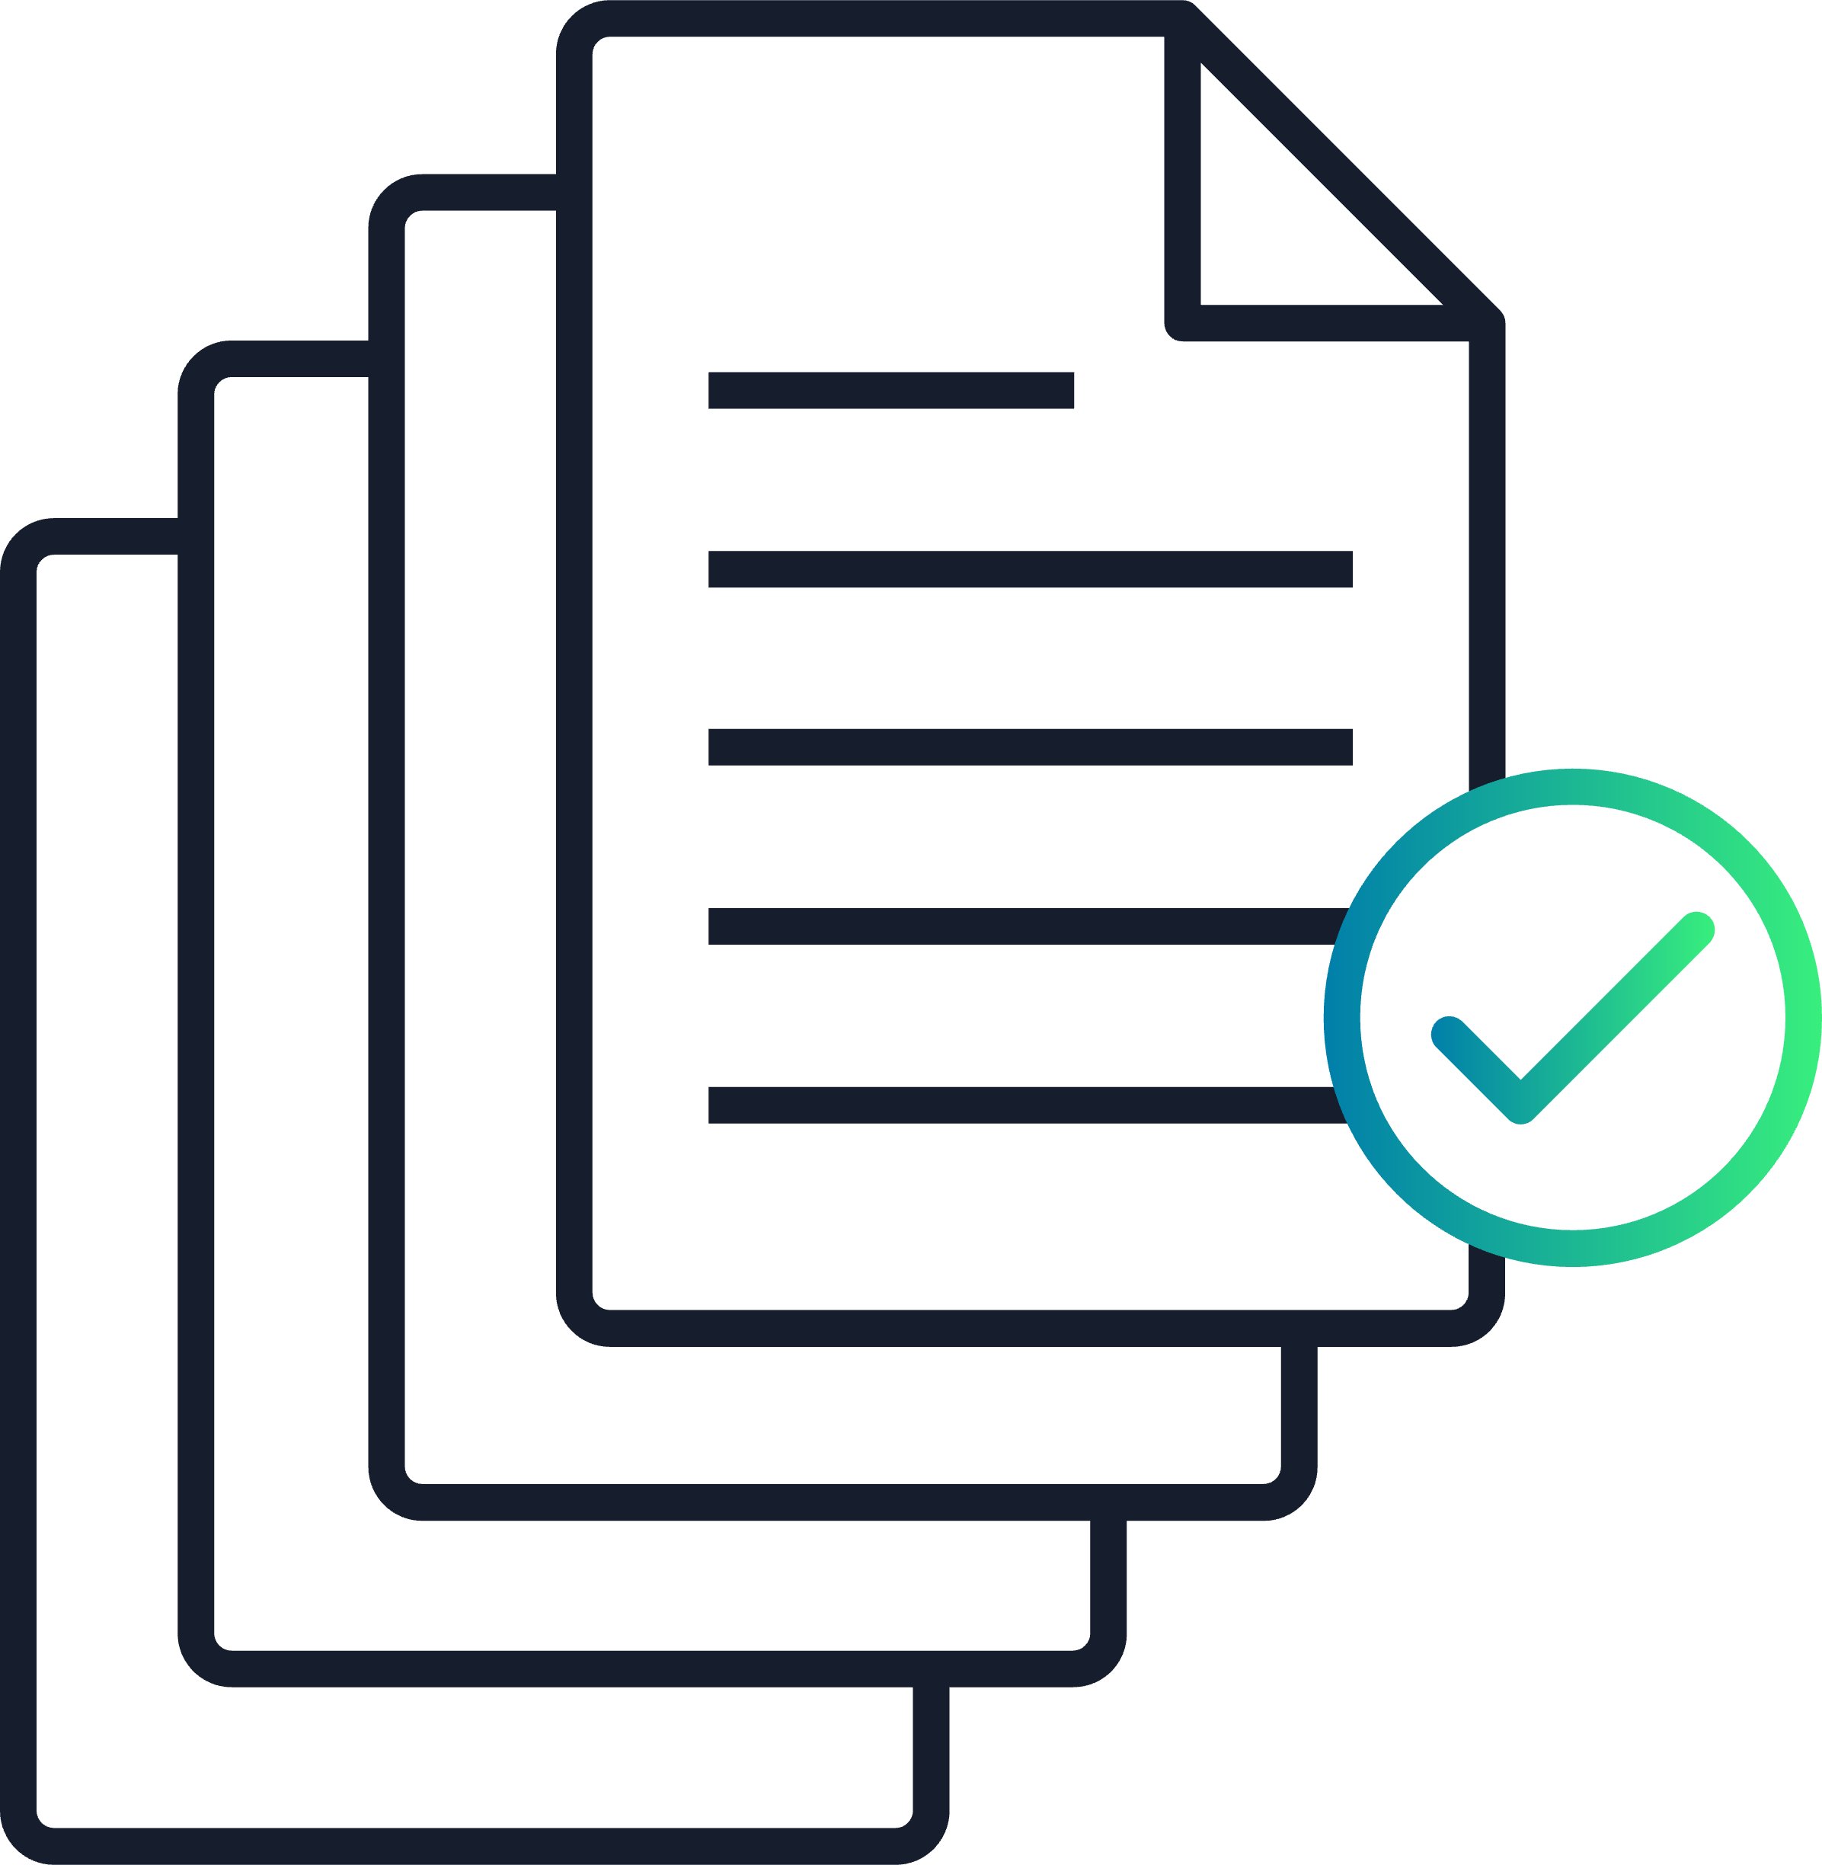
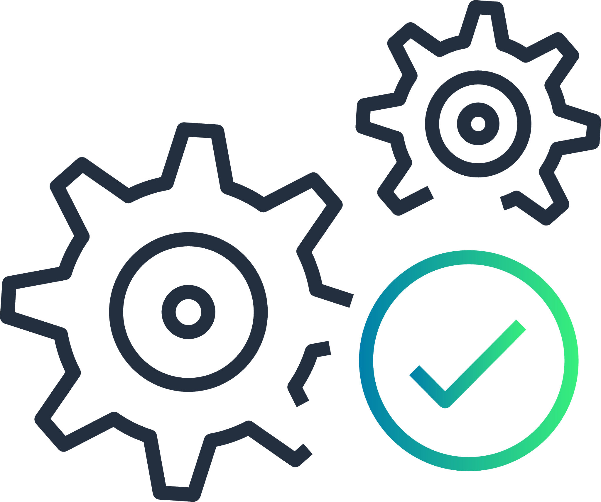
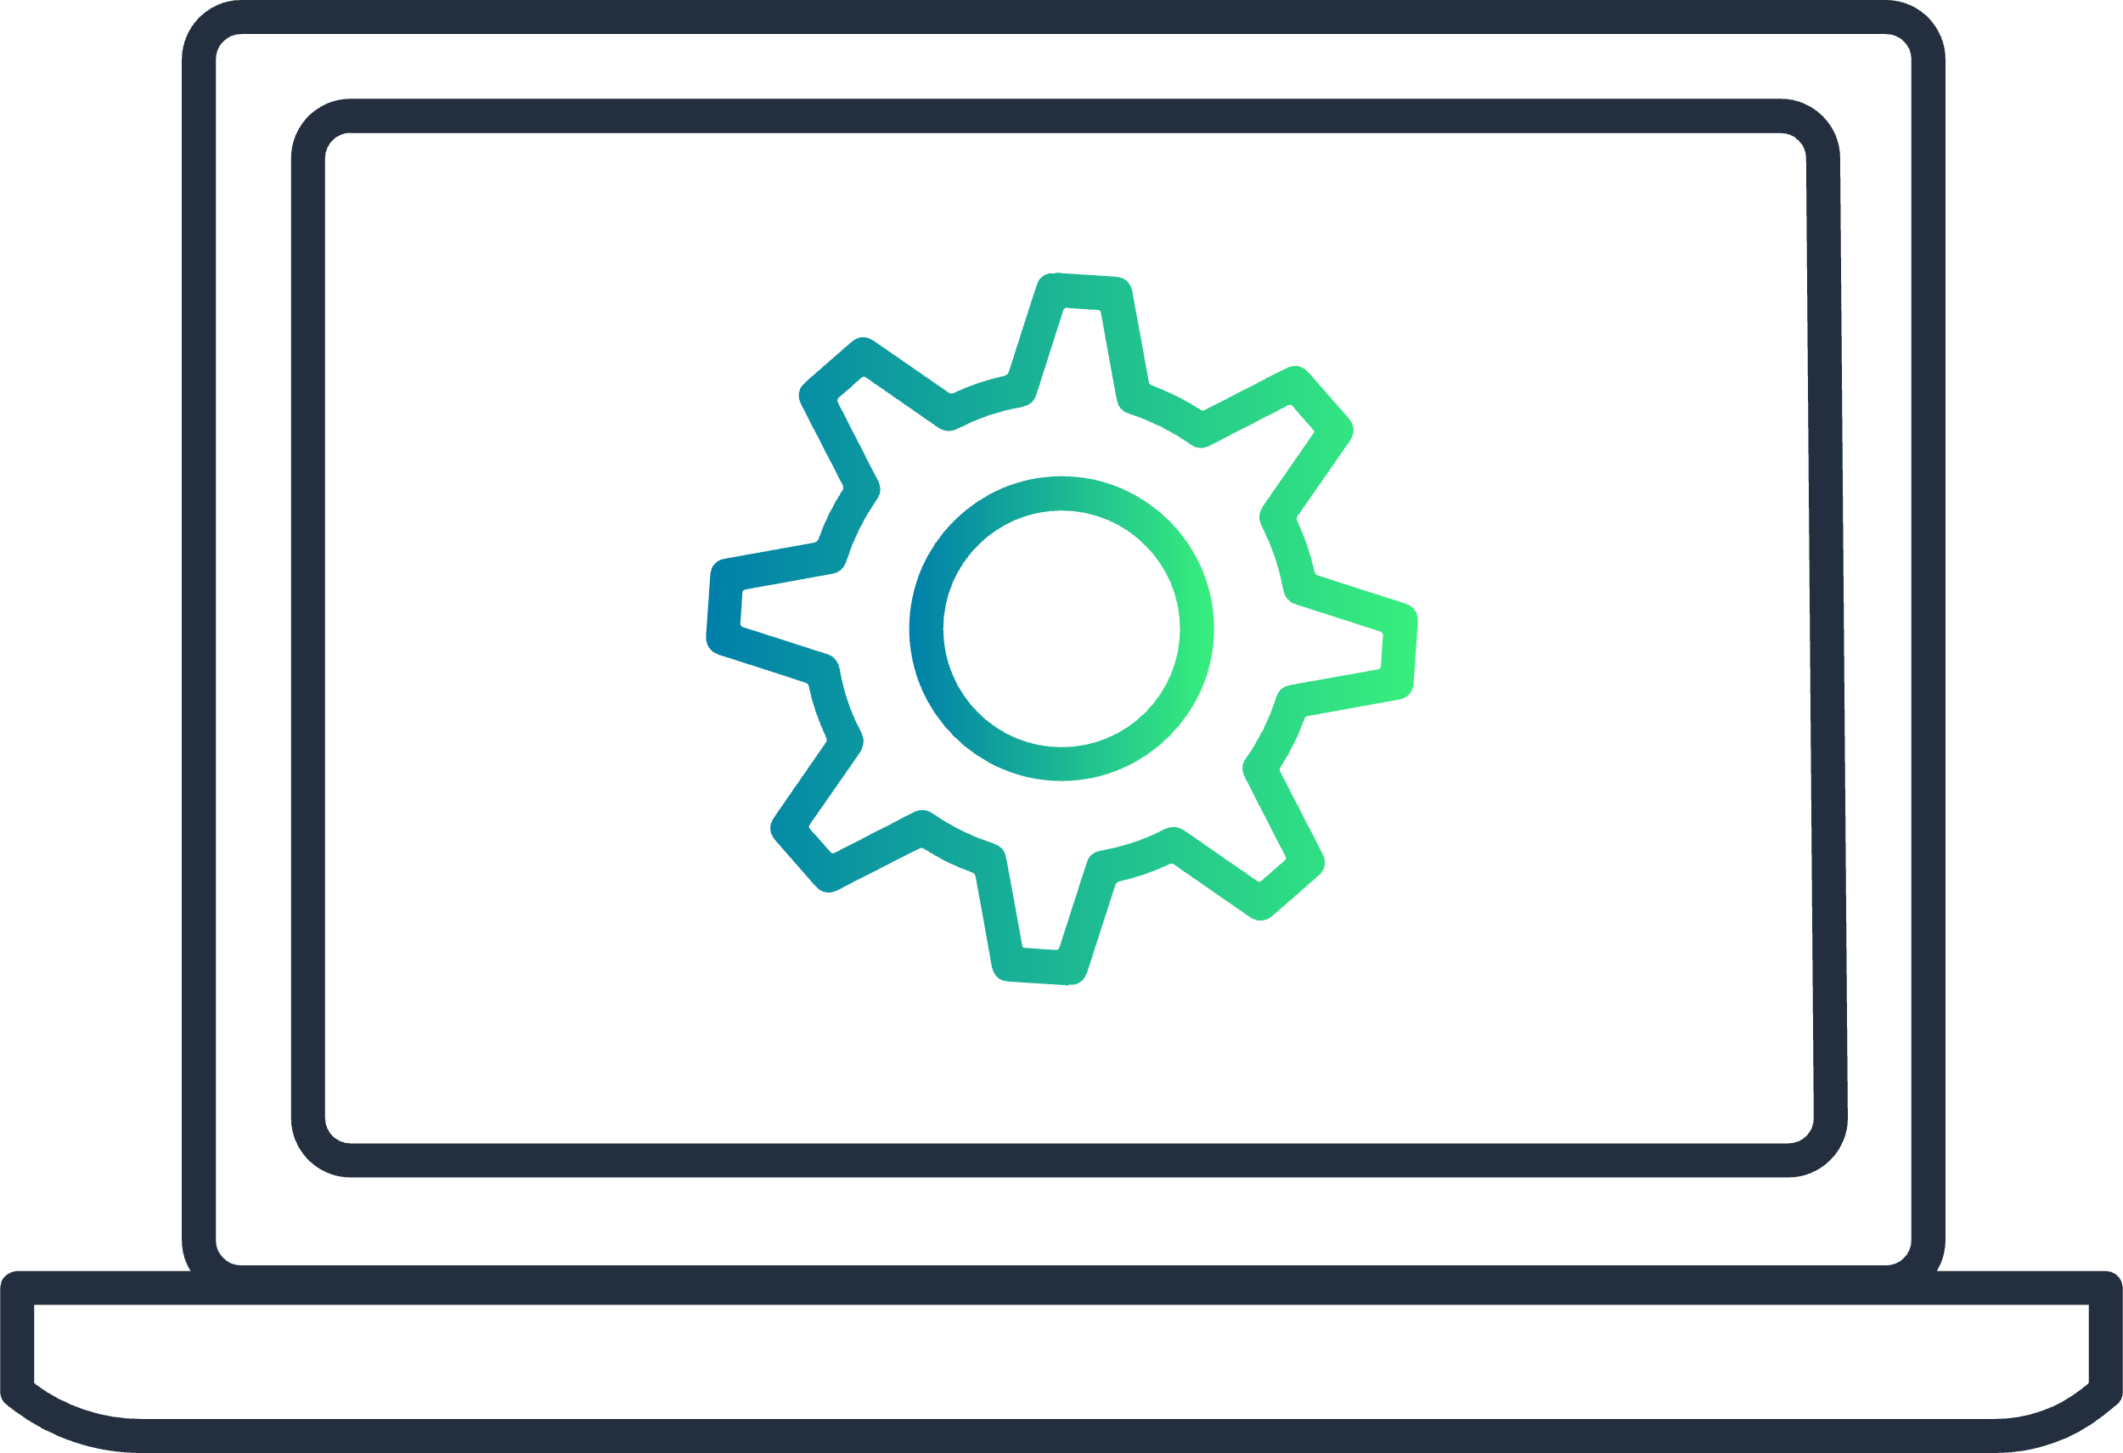
Common enterprise patterns
Lock it all down
Wiki with instructions and examples
Open it back up again
Internal ticketing system
Opinionated approved patterns
Use smarter tools and techniques
Automated pipelines
Developer platforms
Developer owns, Self-serv

Slide 13
OPA on AWS

Slide 14
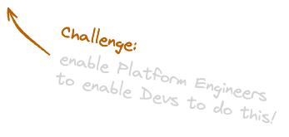
Working Backwards from the Application Developer
Challenge: Prove that It’s possible for a developer with little to no AWS skills to be productive writing cloud native applications while adhering to enterprise organizational best practices.

Slide 15
Where does it all fit?
AWS Control Tower
Internal Developer Platform
Core Controls
Developer Owns, Self-service
Opinionated Patterns
Applications
Application Foundations
Security Foundations
Landing Zones
AWS CDK

Slide 16
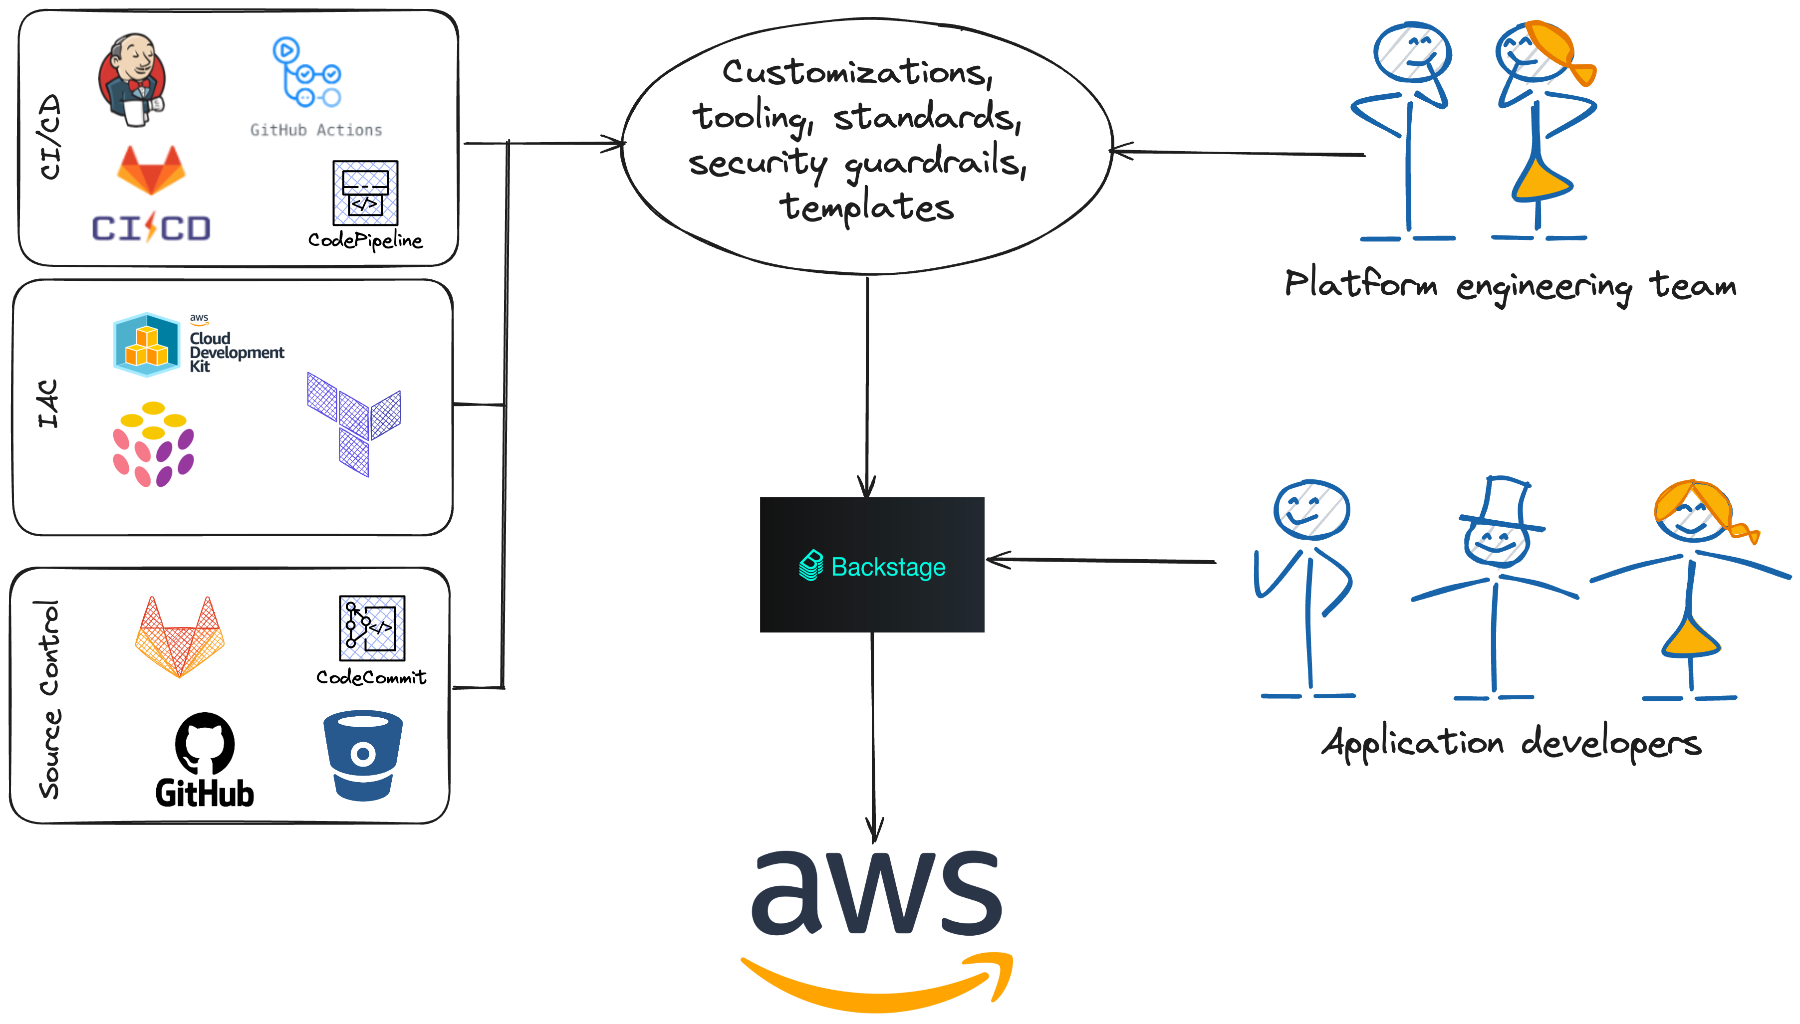
No two organizations are alike

Slide 17
What does it take to build a platform?
Building Application foundations
Embedding security best practices and auditing
Automate application deployment
Building Opinionated templates
Solving Identity mapping
Integrating internal tools
Pilot
Testing and migrations
Minimum 12-16 months
Integrating internal tools
Pilot
Testing and migrations
With OPA – shorten to 4 months

Slide 18
OPA on AWS Approach
4-way principles
Infrastructure is boiled down to a simple name
Organizational standard patterns are boiled down to a wizard
Application-focused UI
Single-pane of glass
No switching to AWS console
Self-Service operations
Utilize existing AWS Services

Slide 19
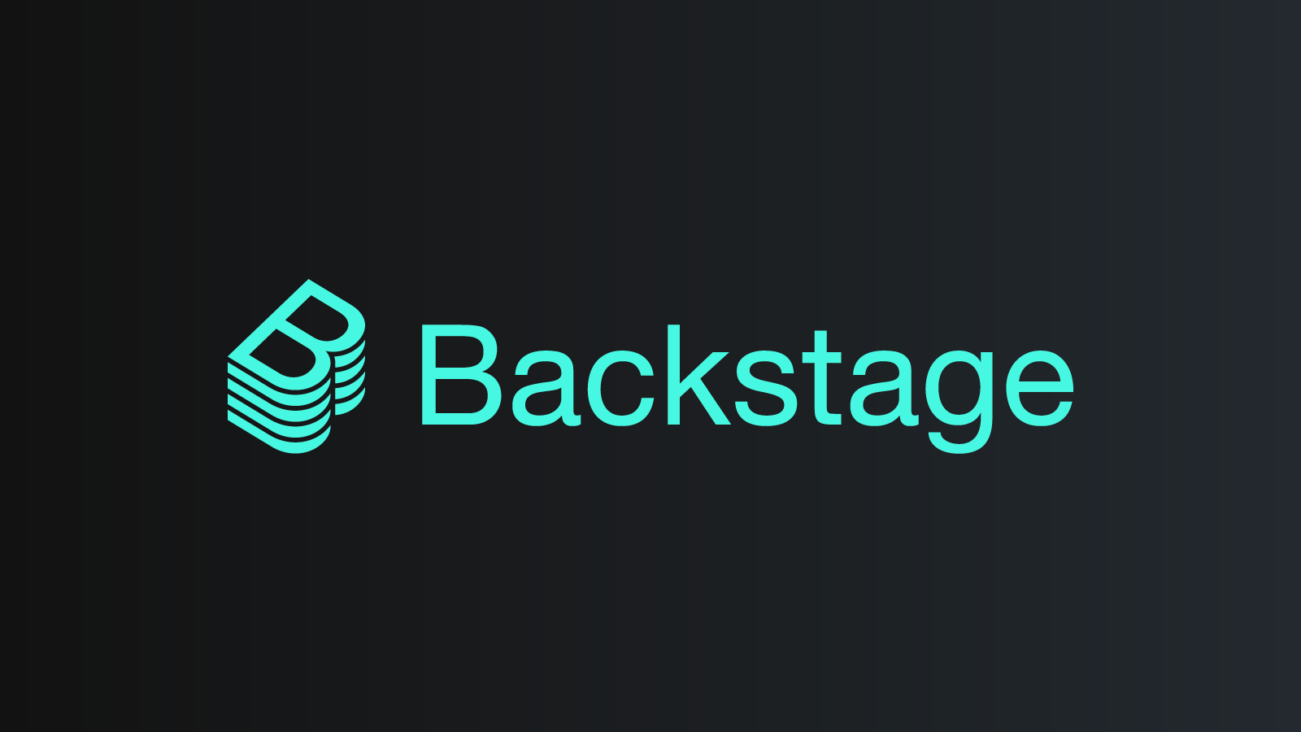
Orchestrate Platform and Applications (OPA!)
Reference implementation of an Internal Developer Platform for AWS
Open source code
Designed for enterprise
Dozens of Templates
Example apps
Backstage plugins
Security best practices
https://opaonaws.io/

Slide 20
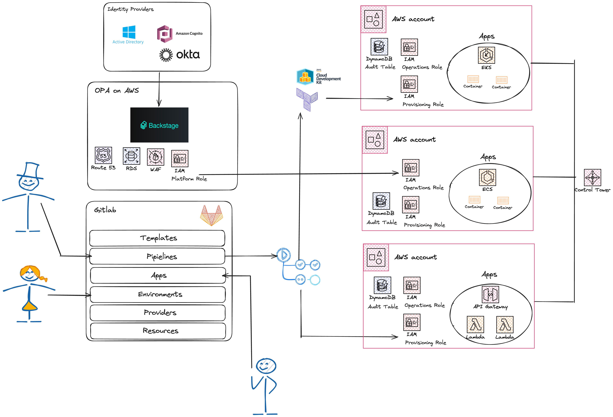
OPA on AWS Architecture

Slide 21
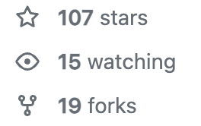
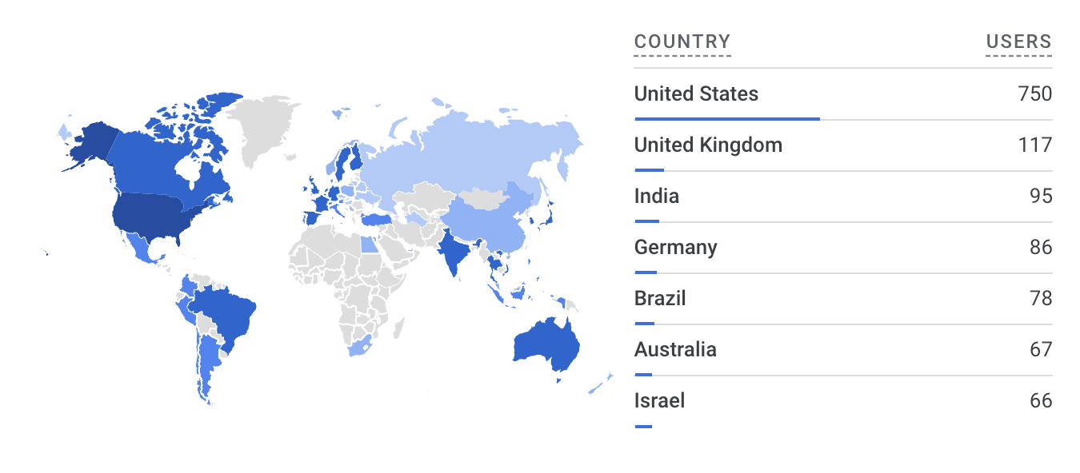
OPA on AWS Around the World
256 users a week
3.4K views a week
58 countries
1.1K+ YouTube views
CUSTOMER QUOTES
“Really made a huge difference to understand at the next level”
“This made my conference! I'm here for OPA” – re:Invent 2023
“It’s the missing piece, we don't have anything like this”
“If you give a developer the right amount of data, they’ll make the right decisions”

Slide 22
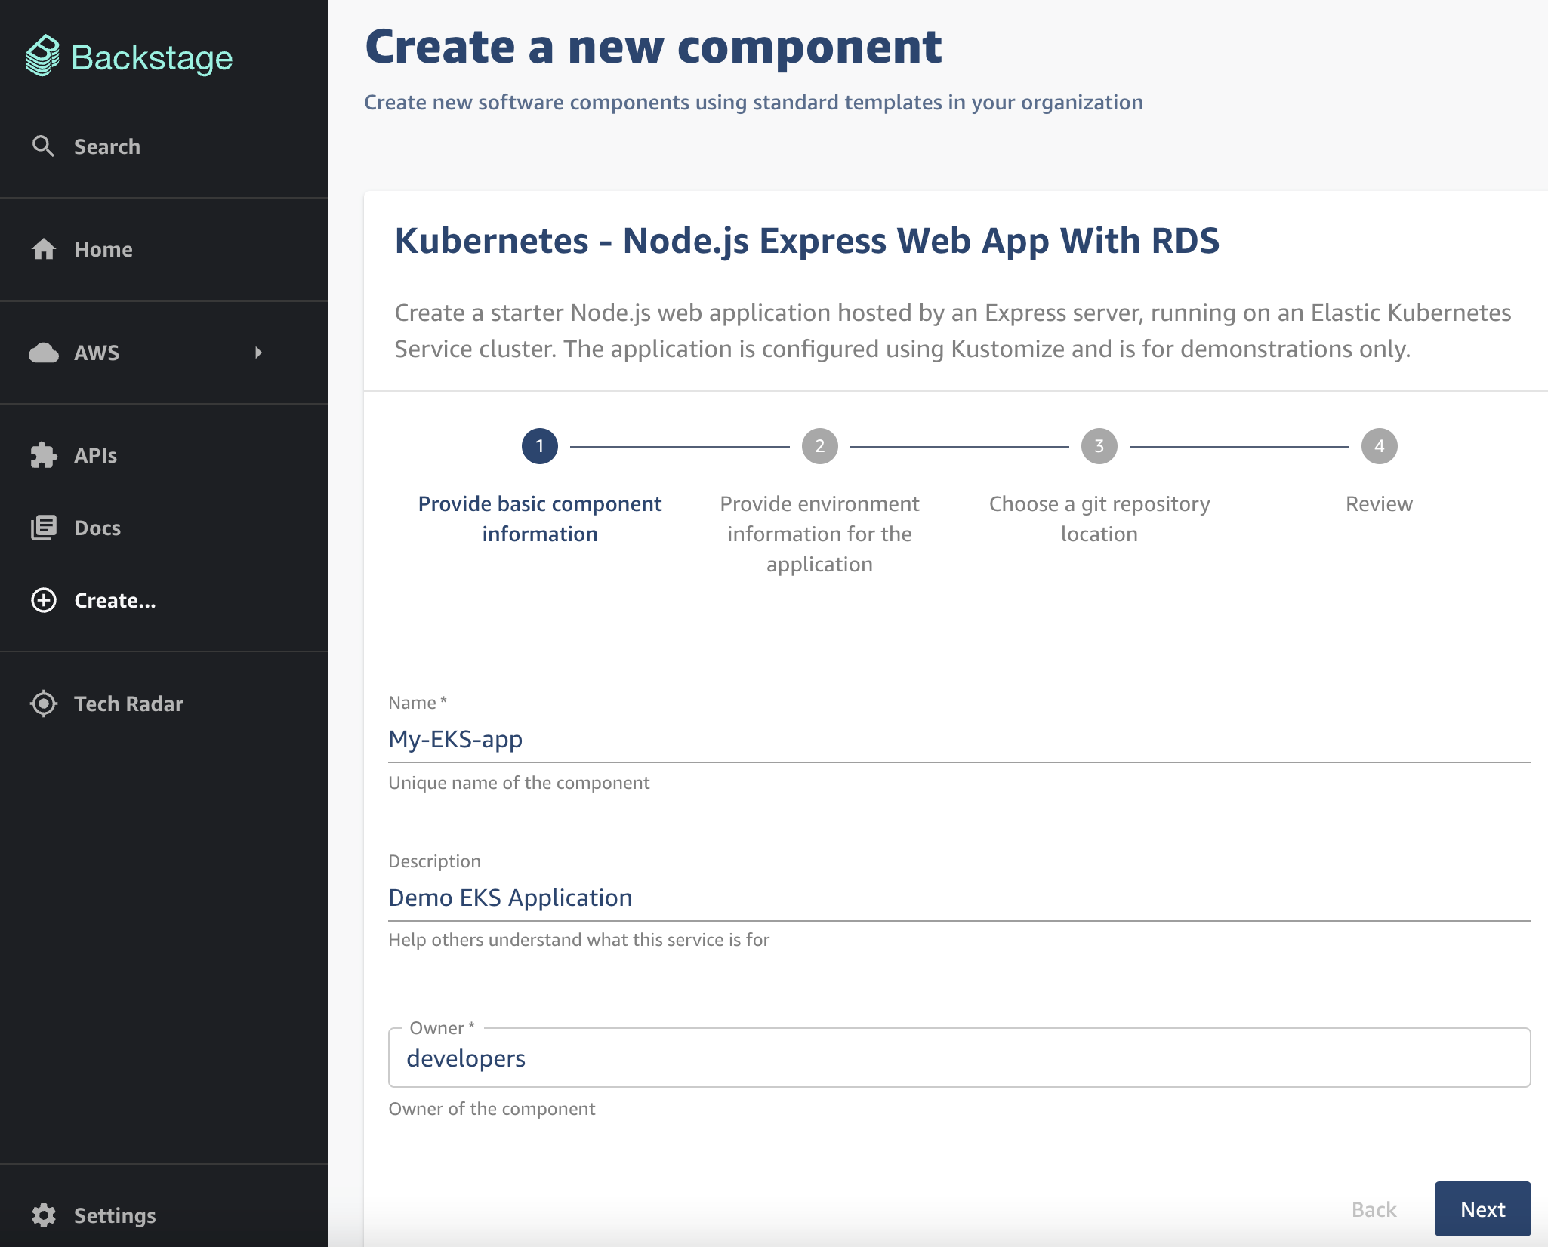
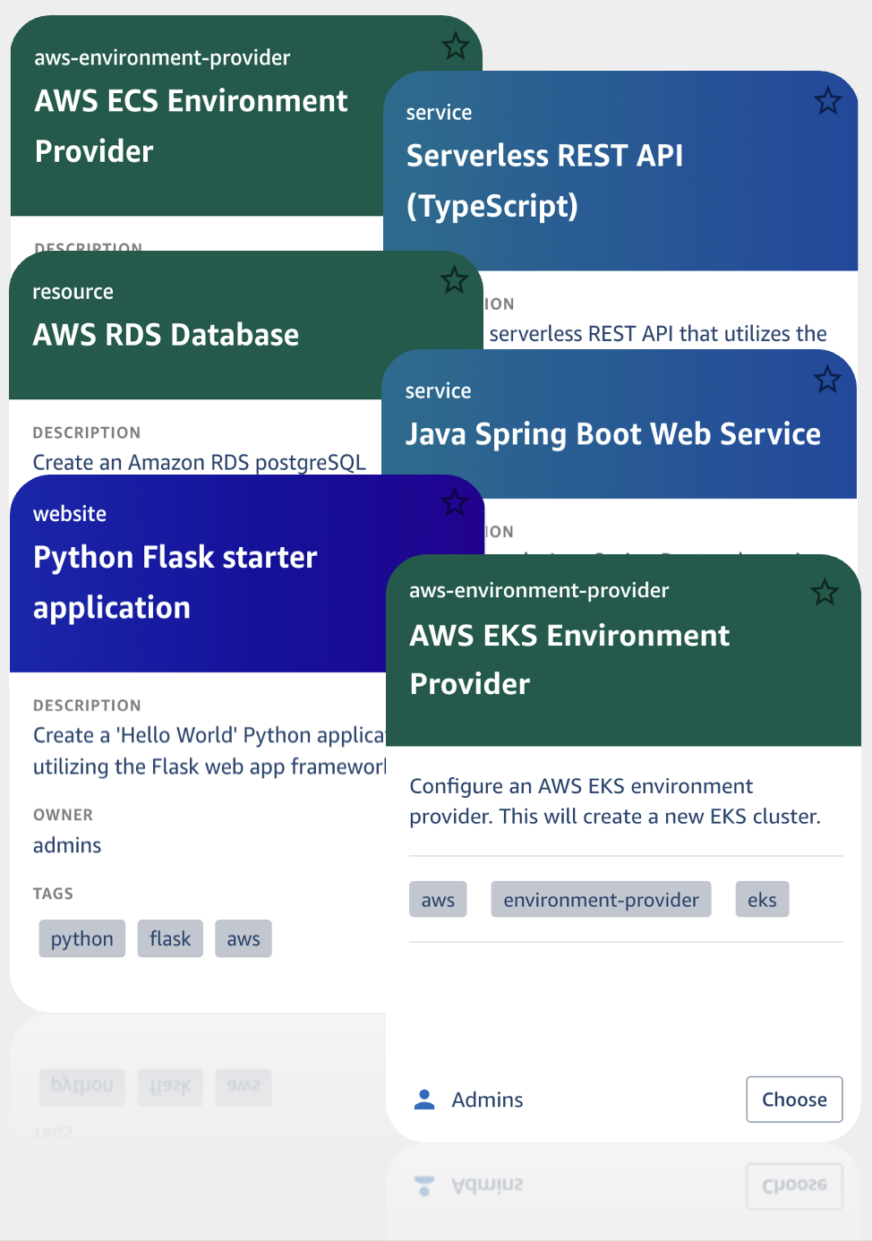
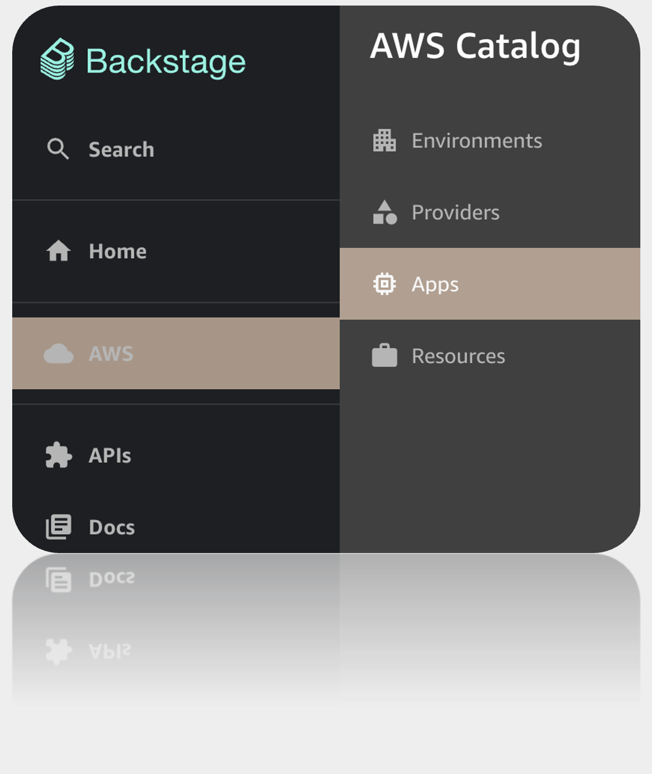
Making developer experience easy

Slide 23
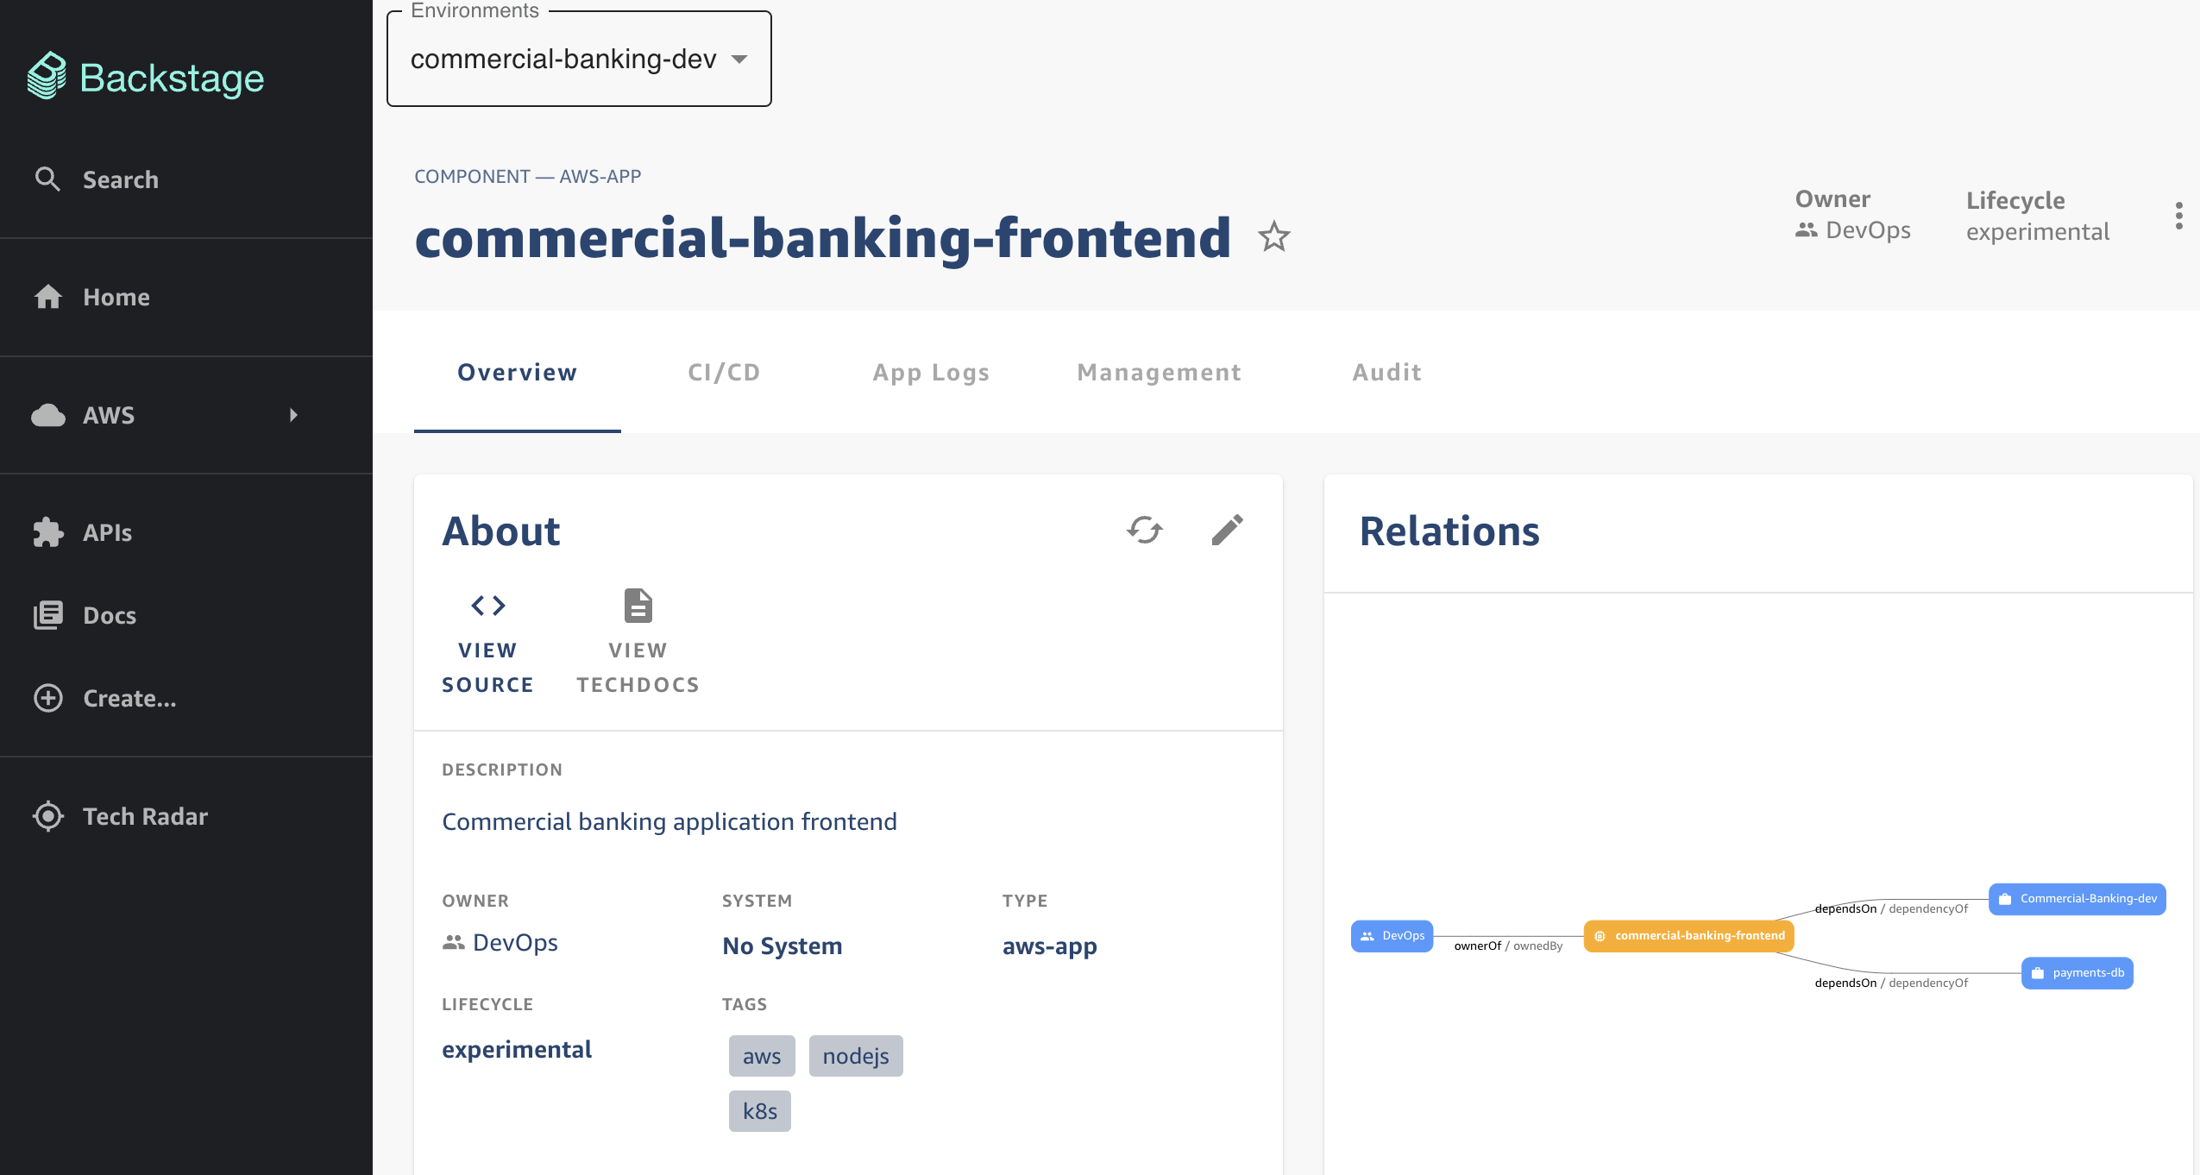
Making developer experience easy
Environment Selector

Slide 24
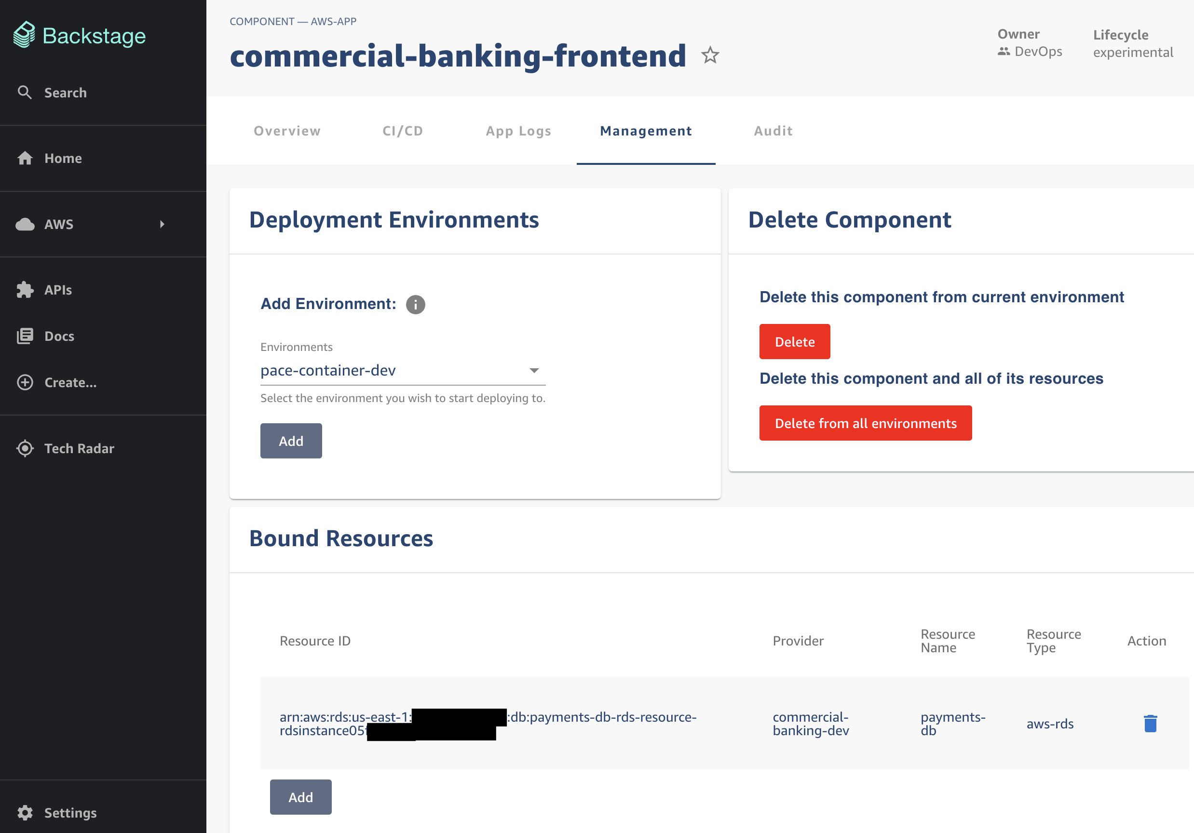
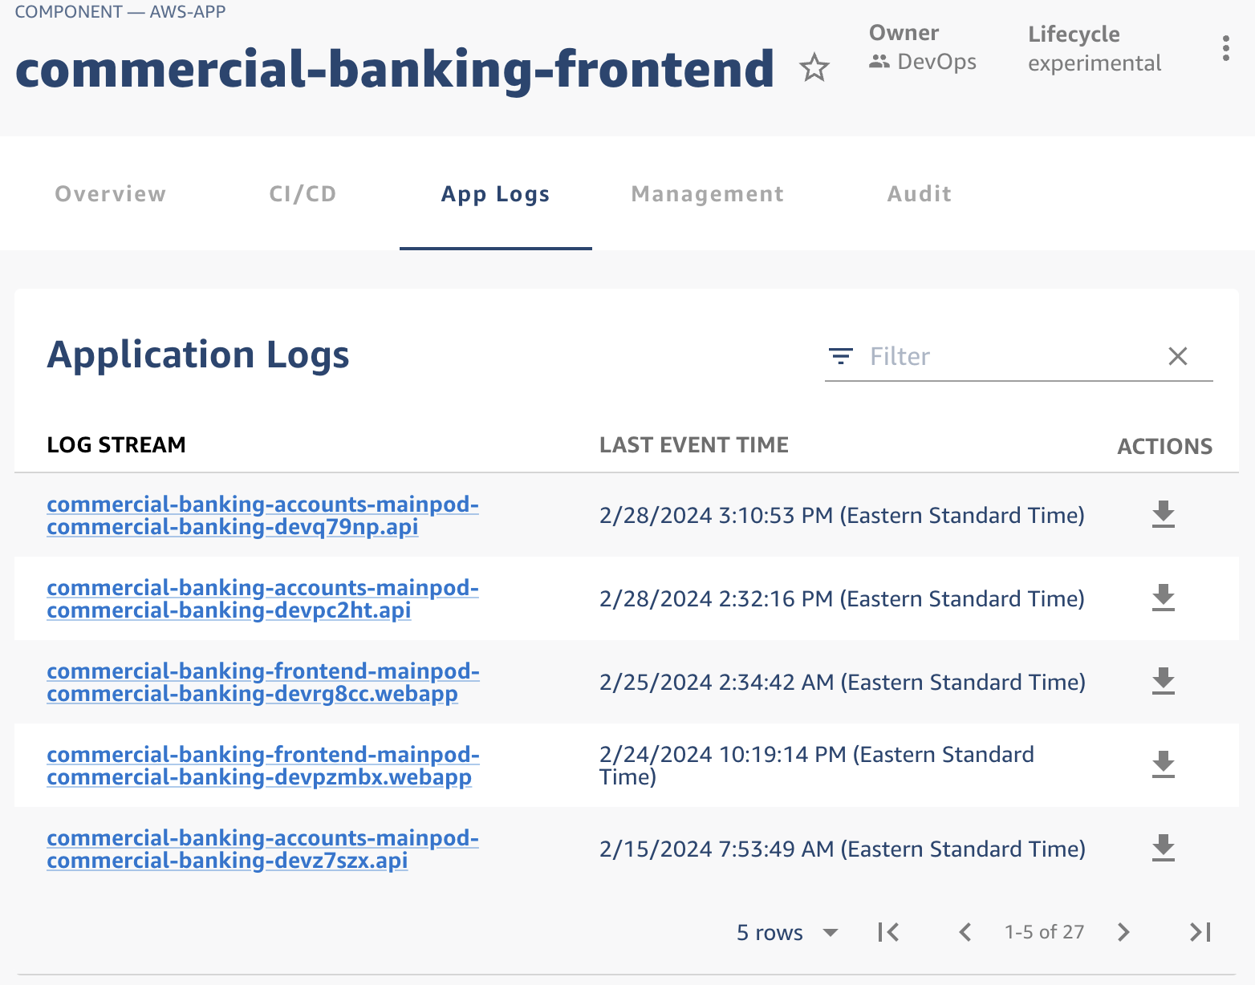
Making developer experience easy

Slide 25
Responsibilities and ownership
Component (apps)
Resources
Application
Developer
Create application or resource
depends On
Environment
references one or more
*
Creates
Environment Provider
Platform
Engineer

Slide 26
Environment Provider overview
Env Provider
AWS account
Region
Virtual private cloud (VPC)
Provisioning
Role
SSM Parameters
Subnet
Subnet
KMS key
Container runtime (ECS / EKS)
Operations
Role
Secrets
Audit Table

Slide 27
fsi-pace-pe@amazon.com

